Slide 1
Practicing Project
Phonebook Program using C
Sripradha : 1RN19CS155
Tejaswini B M : 1RN19CS167
Department of CSE

Slide 2


Introduction
What is Phonebook ?
What are the Phonebook operations ?
What is C Programming Language?
What are the Applications of C ?
What are the advantages and disadvantages of phonebook in C ?
Phonebook in C is a console application without graphics!!
1.Insertion
2.Deletion
3.Modification
4.Searching
5.List
Department of CSE

Slide 3
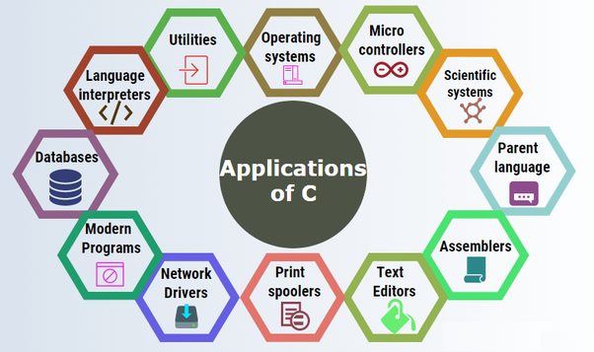
Department of CSE

Slide 4

problem statement
“To develop a Phonebook Management program in C making use of Data Structures & File Handling Functions”
Department of CSE

Slide 5
Technological Requirements
Tools used
Turbo C
Programming
Language
C
Operating System
Windows 10
Online GDB
Software Requirements
Department of CSE

Slide 6
Flowchart for Phonebook Program
Start
menu
Read choice ch
switch(ch)
addrecord()
case 1
deleterecord()
case 2
modifyrecord()
case 3
searchrecord()
case 4
listrecord()
case 5
exit(0)
case 6
Invalid Choice
default
Stop
Department of CSE
Flowchart for main()

Slide 7
Flowchart for addrecord()
addrecord()
Read name, address,
phone-no, e-mail
Print “Record Saved”
menu()
Department of CSE

Slide 8
Flowchart for deleterecord()
deleterecord()
Read contact name to be deleted
if (name matches)
No
Yes
Print “Record Deleted Successfully”
Contact not found
menu()
Department of CSE

Slide 9
Flowchart for modifyrecord()
modifyrecord()
Read contact name to be modified
Yes
if (name matches)
No
Read all details
Contact not found
menu()
Department of CSE

Slide 10
Flowchart for searchrecord()
searchrecord()
Read contact name to be searched
Yes
if (name==search)
No
Print all details
Contact not found
menu()
Department of CSE

Slide 11
Flowchart for listrecord()
listrecord()
Print all records
menu()
Department of CSE

Slide 12
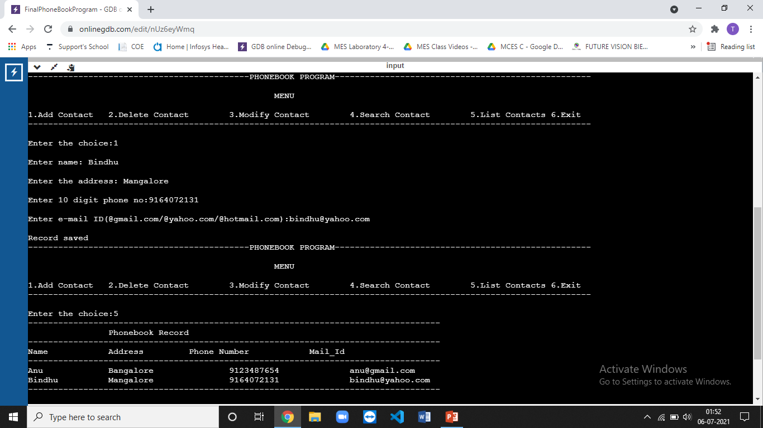
CONCLUSION
“Phonebook program is user friendly and easy to handle”
Department of CSE

Slide 13

Thank you
Queries ??
Any suggestions ?

